Slide 1
CSSE3113 – Introduction to Software Engineering
Requirements Engineering Process & Discovery Techniques

Slide 2
Requirements Engineering Process
Goal of RE Process → to create and maintain a system requirement document
RE processes may Include four high level activities
Assessing whether the system is useful to business and customer (Feasibility Study)
Discovering requirements (elicitation and analysis)
Converting theses requirements into some standard form (specification)
Checking that the requirements actually define the system that the customer wants (validation)

Slide 3
Requirements Engineering Process
The process used for RE vary widely depending on the application domain, the people involved and the organization developing the requirements.
However, there are a number of generic activities common to all processes.
Requirements Elicitation
Requirements Analysis
Requirements Validation
Requirements Management

Slide 4
Feasibility Study
A feasibility study decides whether or not the proposed system is worth implementing.
A feasibility study is short, focused study that take place early in the RE Process
Does the system contributes to organizational objectives?
Can the system be implemented within schedule and budget using current technology?
Can the system can be integrated with other systems that are used?
If the answer to any of these questions is no, you should probably not go ahead with the project.

Slide 5
Requirement Elicitation and Analysis
Sometimes called requirement discovery.
Involves technical staff (software engineers) working with customers to find out about the
application domain
the services that the system should provide and
the system’s operational constraints.
May involve a variety of people in an organization
End-users, managers, engineers involved in maintenance, domain experts etc. These are called stakeholders

Slide 6
Requirement Elicitation and Analysis
Process Activities
Requirements discovery
Interacting with stakeholders to discover their requirements. Domain requirements are also discovered at this stage.
Requirements classification and organization
Groups related requirements and organizes them into coherent clusters.
Prioritization and negotiation
Prioritizing requirements and resolving requirements conflicts through negotiation.
Requirements documentation(Specification)
Requirements are documented.

Slide 7
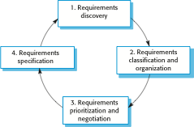
Requirements Elicitation and Analysis Process

Slide 8
Problems of Requirements Analysis
Understanding stakeholder requirements is difficult for several reasons
Stakeholders don’t know what they really want.
Stakeholders express requirements in their own terms.
Different stakeholders may have conflicting requirements.
Organizational and political factors may influence the system requirements.
The requirements change during the analysis process. New stakeholders may emerge and the business environment change.

Slide 9
Requirements Discovery
The process of gathering information about the proposed and existing systems
Refining the user and system requirements from this information.
Sources of information include system stakeholders and the specifications of similar systems.

Slide 10
Techniques of Requirement Discovery
Interview:
Formal or informal interview with the system stakeholders
In this, the RE team puts questions to stakeholders about the system that they currently use and the system to be developed.
There are two types of interview
Closed interviews: where the stakeholders answers a pre-defined set of questions.
Open interviews: in which there is no pre-defined agenda and a range of issues are explored with stakeholders.

Slide 11
Effective Interviewers
Interviewers should be open-minded.
Avoid pre-conceived ideas about the requirements, and willing to listen to stakeholders.
If the stakeholder comes up with surprising requirements , willing to change their minds about the system.
They prompt the interviewee to get with discussion using a question or a proposal.

Slide 12
User Stories
User stories are commonly used in adaptive or agile methodologies
Short, high-level descriptions of required functionality expressed in customer terms.
A typical user story has the form: “As a <role>, I want <goal/desire> so that <benefit>.”
Just enough information so that the developers can produce a reasonable estimate of the effort to implement it.
The aim is to avoid some of the waste that often happens in projects where detailed requirements are gathered early but become invalid before the work begins.

Slide 13
Example

Slide 14
Social and Organizational Factors
Software systems do not exist in isolation – they are used in a social and organizational context.
This can influence or even dominate the system requirements.
Good analysts must be sensitive to these factors.

Slide 15
Example
Consider a system which allows senior management to access information without going through middle managers
Managerial status. Senior managers may feel that they are too important to use a keyboard. This may limit the type of system interface used
Managerial responsibilities. Managers may have no uninterrupted time where they can learn to use the system
Organisational resistance. Middle managers who will be made redundant may deliberately provide misleading or incomplete information so that the system will fail

Slide 16
Ethnography
Ethnography is an observational technique that can be used to understand social and organizational requirements.
An analyst immerses him or herself in the working environment (where the system will be used)
Help analyst to discover implicit system requirements.

Slide 17
Requirements Validation
Concerned with demonstrating that the requirements define the system that the customer really wants.
Requirements error costs are high so validation is very important
Fixing a requirements error after delivery may cost up to 100 times the cost of fixing an implementation error.

Slide 18
Requirements Checking
Checks include
Validity. Does the system provide the functions which best support the customer’s needs?
Consistency. Are there any requirements conflicts?
Completeness. Are all functions required by the customer included?
Realism. Can the requirements be implemented given available budget and technology

Slide 19
Requirements Validation Techniques
Requirements reviews:
Systematic manual analysis of the requirements(by a team of reviewers) who check for error and inconsistencies.
Prototyping:
Using an executable model of the system to check requirements.
Test-case generation:
Developing tests for requirements to check testability.

Slide 20
Requirements Management
Requirements management is the process of managing changing requirements during the requirements engineering process and system development.
New requirements emerge during the process as business needs change and a better understanding of the system is developed

Slide 21
Requirement Modelling
The intent of the analysis/requirement model is to provide a description of the required informational, functional, and behavioral domains for a computer-based system.
The model changes dynamically as you learn more about the system to build.
Other stakeholders understand more about what they really require.
There are different modes of representation that force you to consider requirements from different viewpoints---an approach that has a higher probability of uncovering omissions, inconsistencies, and ambiguity.

Slide 22
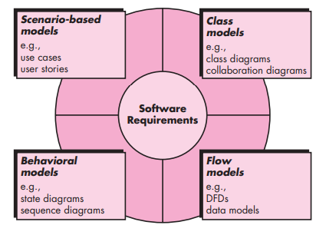
Requirement Modelling

Slide 23
Scenarios
People usually find it easier to relate to real-life examples rather than abstract descriptions.
Scenarios are real-life examples of how a system can be used.
Through Scenario user can understand and criticize….how they might interact with a software system.
Requirement engineers can use the information gained from this discussion to formulate the actual system requirements.

Slide 24
Scenarios
They should include:
A description of the starting situation
A description of the normal flow of events
A description of what can go wrong
Information about other concurrent activities
A description of the state when the scenario finishes.

Slide 25
LIBSYS Scenario

Slide 26
LIBSYS Scenario

Slide 27
Scenario-based Modelling
The scenarios often called use cases, proved a description of how the system will be used.
In essence, a use case tells a stylized story about how an end user interacts with the system under a specific set of circumstances.
The story can be a narrative text, an outline of tasks or interactions, a template-based description, or a diagrammatic representation.

Slide 28
Scenario-based Modelling- Use case
A collection of user scenarios that describe the thread of usage of a system
Each scenario is described from the point-of-view of an “actor”—a person or device that interacts with the software in some way ( not necessarily users) to External entities.
For example, a machine in four different modes of programming, test, monitoring and troubleshooting modes. Four actors can be defined. Programmer, tester, monitor, and troubleshooter.
In some cases, the machine operator can play all of these roles. Or different people can play different roles.

Slide 29
Scenario-based Modelling- Use case
Once actors are defined, use cases can be developed. Each scenario answers the following questions:
Who is the primary actor, the secondary actor (s) ( to support the primary actors)?
What are the actor’s goals?
What preconditions should exist before the story begins?
What main tasks or functions are performed by the actor?
What extensions might be considered as the story is described?
What variations in the actor’s interaction are possible?
What system information will the actor acquire, produce, or change?
Will the actor have to inform the system about changes in the external environment?
What information does the actor desire from the system?
Does the actor wish to be informed about unexpected changes?

Slide 30
system name
system boundary
ATM System
primary actor
1
Withdraw
Money
secondary actor
2
Deposit
Money
Bank Customer
Customer Accounts Database
3
Transfer
Money
role
association
4
Check
Balance
<<Customer
Accounts
Database>>
use case
alternative actor notation
stereotype

Slide 31
Dependency –Among Use Cases
Two Stereotypes of Dependency Among Use Cases:
extend: the target use case extends the behavior of the source
include: the source use case explicitly incorporates the behavior of another use case at a location specified by the source
System
Use Case A
Actor
<<include>>
<<extend>>
Order Processing System
Place Order
<<actor>>
Actor
Use Case B
Use Case C
Extension points
Additional requests:
after creation of
the order
<<extend>>
Request Catalog
1
*
The sales person
asks for the catalog
SalesPerson
<<include>>
<<include>>
<<include>>
Supply Customer Info.
Order Item
Make Payment

Slide 32
Generalization –Among Actors
Place Order
Extension points
Additional requests:
after creation of the order
1
*
SalesPerson
Sales person can do only “Place Order”;
Sales manager can do both “Place Order”
and “Grant Credit”
Grant Credit
1
*
SalesManager

Slide 33
Class-based Modelling
It shows the classes of the system, their inter-relationships, and the operations and attributes of the classes
Explore domain concepts in the form of a domain model
Analyze requirements in the form of a conceptual/analysis model

Slide 34
Class-based Modelling
Class-based modeling represents:
Objects that the system will manipulate
Operations (also called methods or services) that will be applied to the objects to effect the manipulation
Relationships (some hierarchical) between the objects
Collaborations that occur between the classes that are defined.
The elements of a class-based model include classes and objects, attributes, operations, and collaboration diagrams.

Slide 35
Identifying Classes
Examining the usage scenarios developed as part of the requirements model and perform a "grammatical parse“.
Classes are determined by underlining each noun or noun phrase and entering it into a simple table.
Synonyms should be noted.
If the class (noun) is required to implement a solution, then it is part of the solution space; otherwise, if a class is necessary only to describe a solution, it is part of the problem space.
But what should we look for once all of the nouns have been isolated?

Slide 36
Class
A class is a description of a set of
objects that share the same attributes,
operations, relationships, and semantics.
Graphically, a class is rendered as a
rectangle, usually including its name,
attributes, and operations in separate,
designated compartments.
ClassName
attributes
operations
Notes:
Semantic-> meaning and interpretation of words

Slide 37
Class Name
ClassName
The name of the class is the only required tag in the graphical representation of a class. It always appears in the top-most compartment.
attributes
operations

Slide 38
Class Attributes
Person
An attribute is a named property of a
class that describes the object being modeled.
In the class diagram, attributes appear in the second compartment just below the name-compartment.
name : String
address : Address
birthdate : Date
CNIC : Id

Slide 39
Class Operations
Person
name : String
address : Address
birthdate : Date
CNIC : Id
eat
sleep
work
play
Operations describe the class behavior
and appear in the third compartment.

Slide 40
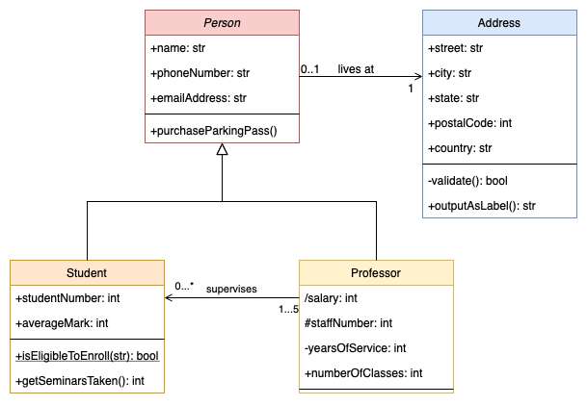
Class Diagram - Example

Slide 41
Behavioral Modelling
State Diagram is a type of behavioral model
Depicts data and behavior of a single object throughout its lifetime.
Elements of State Diagram
Set of states (including an initial start state)
Transitions between states
Entire diagram is drawn from that object's perspective

Slide 42
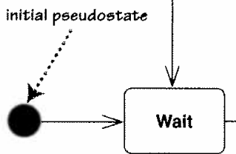
States
State: Conceptual description of the data in the object
Represented by object's field values
Entire diagram is drawn from the central object's perspective
Only include states / concepts that this object can see and influence
Don't include every possible value for the fields; only ones that are conceptually different

Slide 43
Example Scenario
During the Seminar enrollment period at the University of Central Punjab, Dr. Hasan Rizvi and academic coordinator Ms. Ayesha Khan witnessed firsthand how students like Bilal, Usman, and Fatima struggled with a broken manual enrollment process, highlighting the critical need for an Online Seminar Enrollment System. The system must provide automated registration with a centralized digital platform that eliminates lengthy queues and paper-based forms, alongside real-time seat availability tracking and automatic waitlisting with SMS notifications to prevent students from being turned away after hours of waiting. The system must also support phased enrollment workflow allowing students to temporarily hold seats while reviewing seminar details, along with role-based access control, automated email confirmations, a searchable seminar catalog with filters, and digital payment integration. By addressing these requirements, the system will transform the chaotic enrollment experience into a streamlined, equitable, and efficient process that supports the university's commitment to interdisciplinary skill development.

Slide 44
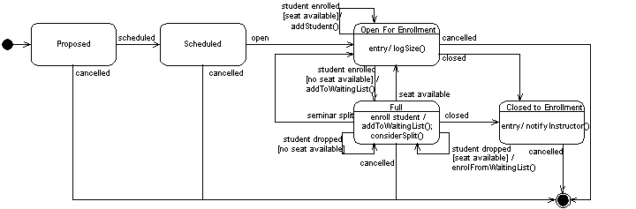
UML Statechart Diagram: Seminar during enrollment

